Slide 1


Slide 2

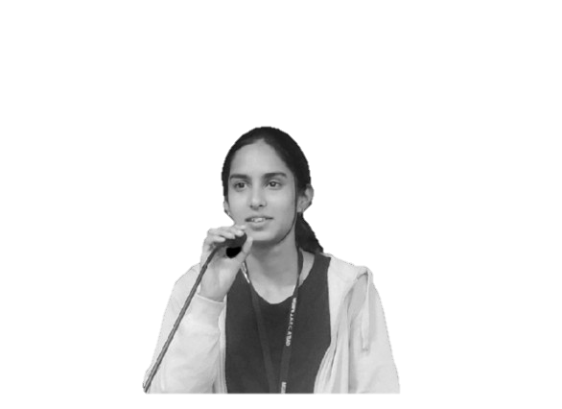


Team Ironman
Prathmesh Shekade
Rushikesh Gore
Pratik Modi
Ekta Joge
IT 3rd year
IT 2nd year
IT 2nd year
IT 2nd year

Slide 3

Quality Education
Problem Statement
In many parts of the world, students face challenges like limited resources, unequal opportunities, and outdated teaching methods, preventing them from receiving the quality education they deserve, a crucial step towards achieving a brighter future.

Slide 4

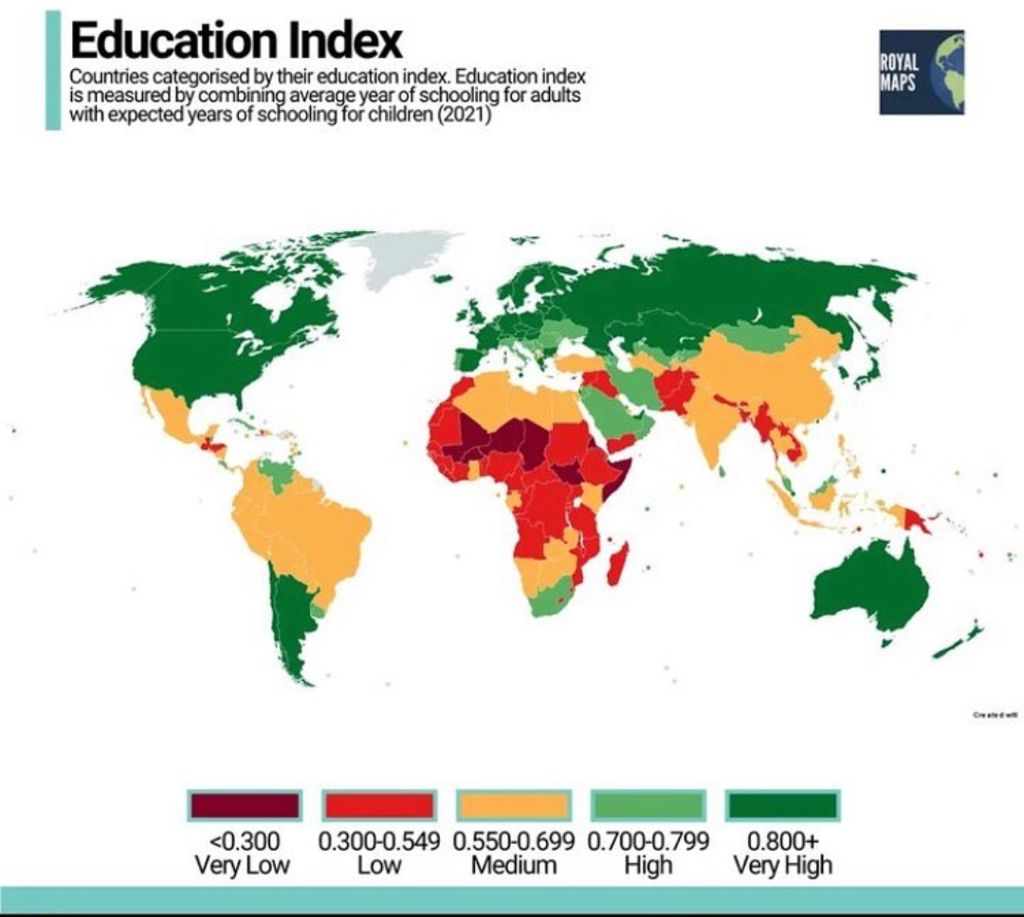

Slide 5

GOAL(S) AND TARGET(S)
By 2030, ensure that all girls and boys complete free, equitable and quality primary and secondary education leading to relevant and Goal-4 effective learning outcomes
By 2030, ensure that all girls and boys have access to quality early childhood development, care and preprimary education so that they are ready for primary education
By 2030, ensure equal access for all women and men to affordable and quality technical, vocational and tertiary education, including university
By 2030, substantially increase the number of youth and adults who have relevant skills, including technical and vocational skills, for employment, decent jobs and entrepreneurship
Build and upgrade education facilities that are child, disability and gender sensitive and provide safe, nonviolent, inclusive and effective learning environments for all

Slide 6
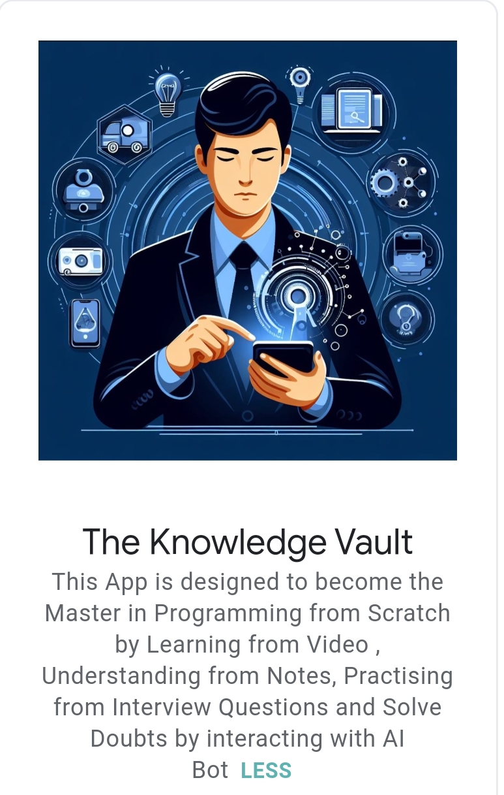
Our Inspiration
Our Solution
Confidence Seekers
Aspiring Coders
Job seekers in Tech
Concept Reviewers
Unified Platform

Slide 7

Justification for Our Solution
pocket-sized personal tutor for BTech studies.
Engaging videos, AI assistance, and clear notes in one place.
Shortcut to acing exams and excelling in job interviews.
Easy and fun learning experience with The Knowledge Vault.

Slide 8
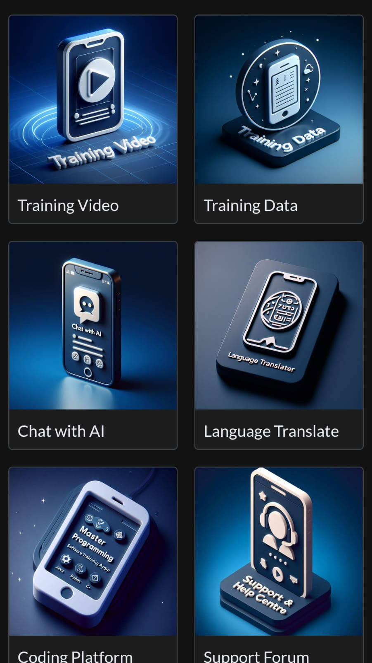
Architecture of Our Solution & Choice of Products/Platforms
Various notes and Interview Questions for quick revisions
Organised videos from basic to advance
.
Integrated AI Tools:
Microsoft copilot, Chat Gpt,
Google Bard ,
Black box AI, Gemini AI, perplex AI , Taskade AI
translating and converting text to speech from any regional or universal language
compiler are there to run and check the code for better understanding and learning
We provide support to user which want to interact with us .

Slide 9
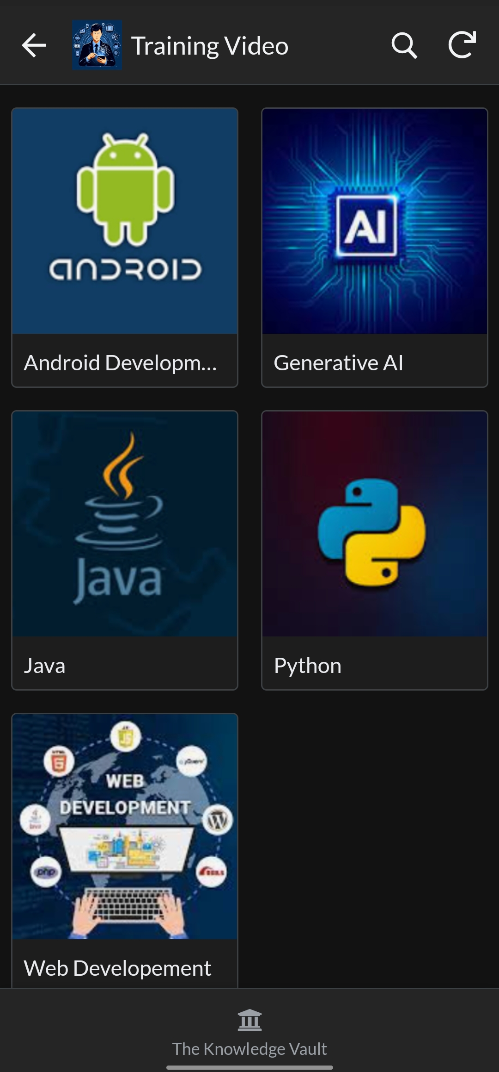
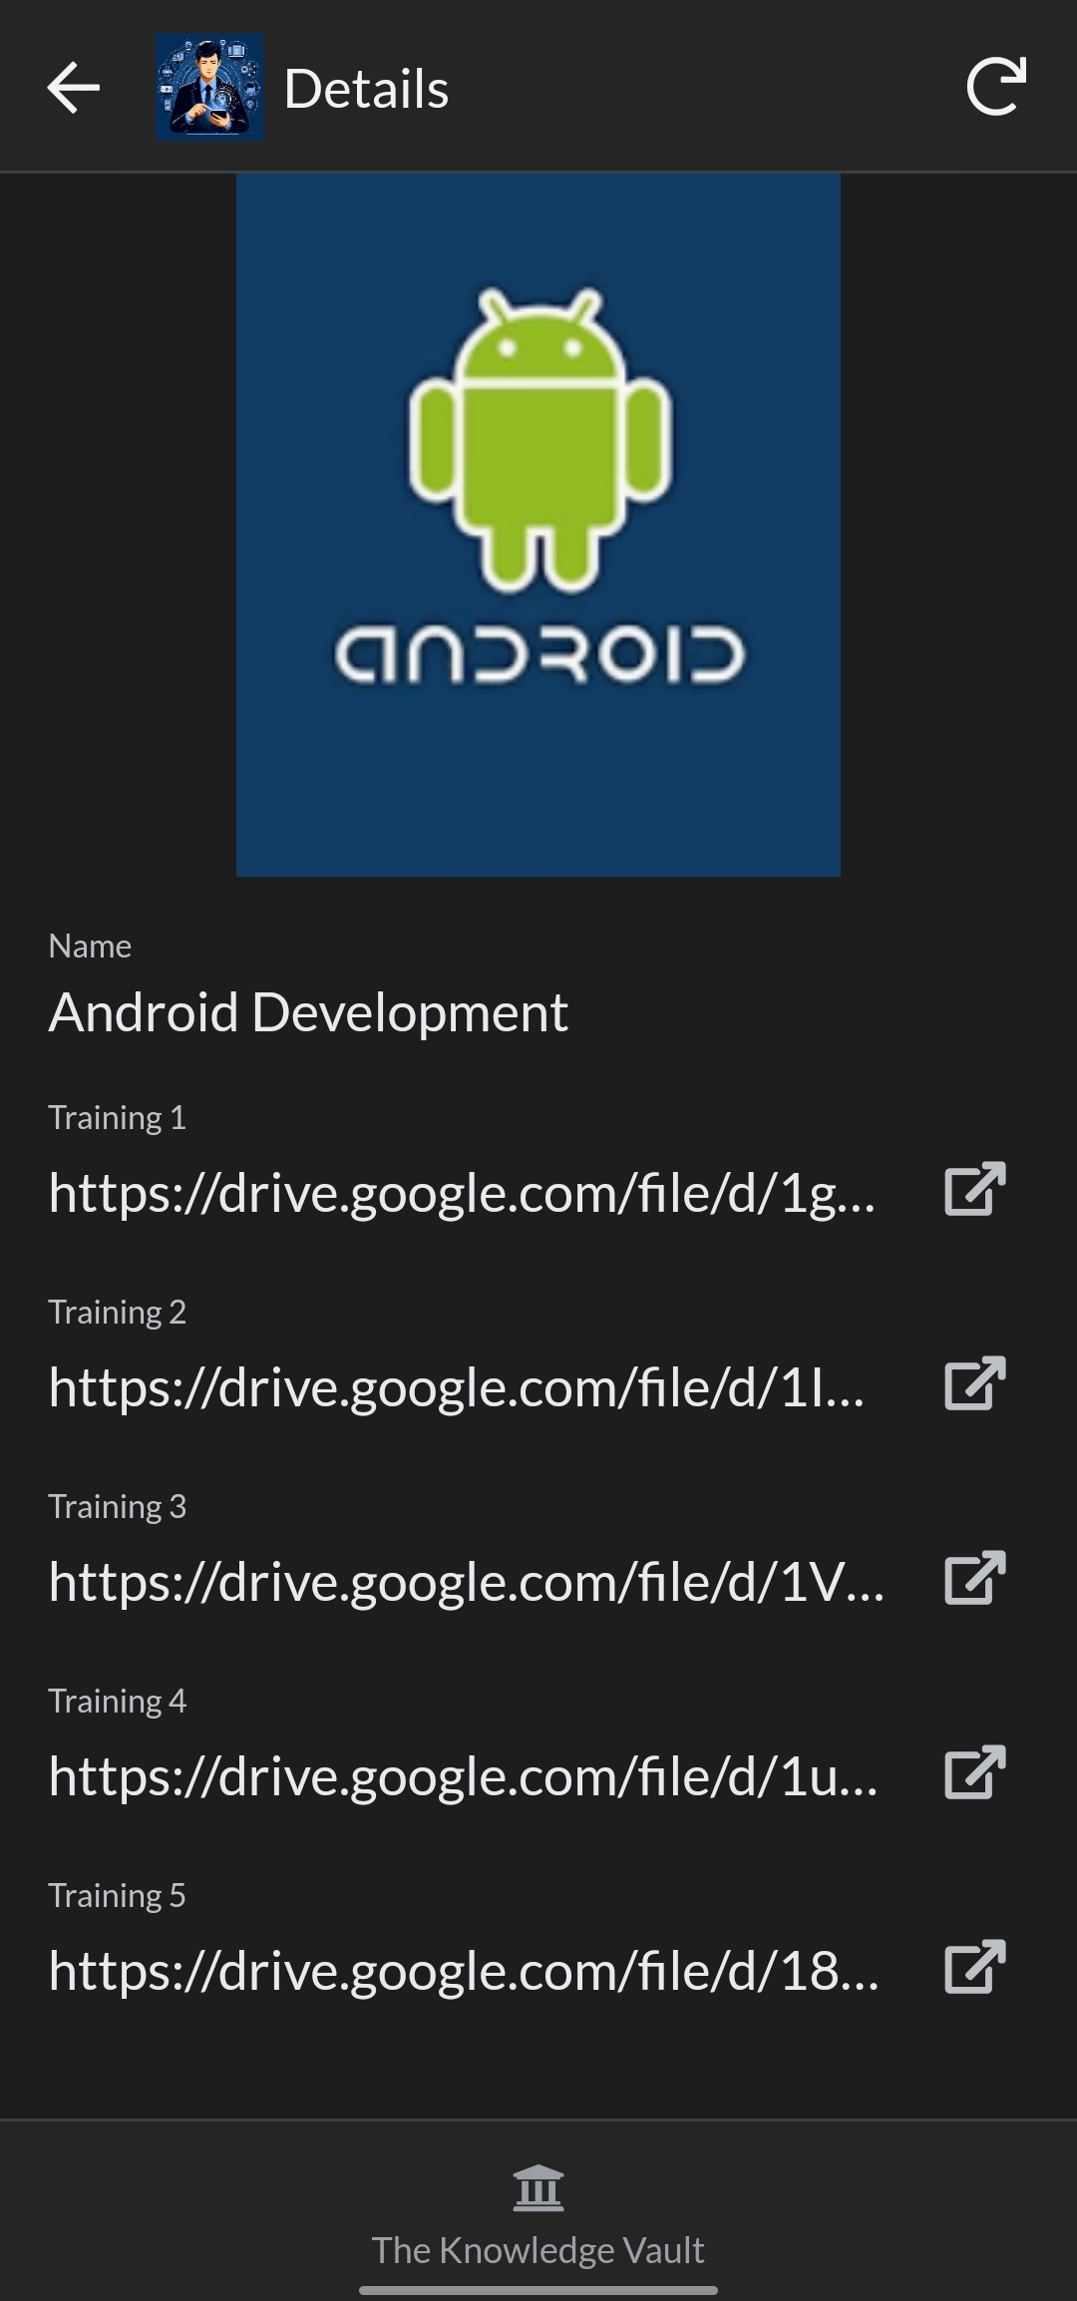

In training video there are Traning videos of which help you to understanging programing from basic to advance, in clearing doubts and being master in particular programming domain.

Slide 10
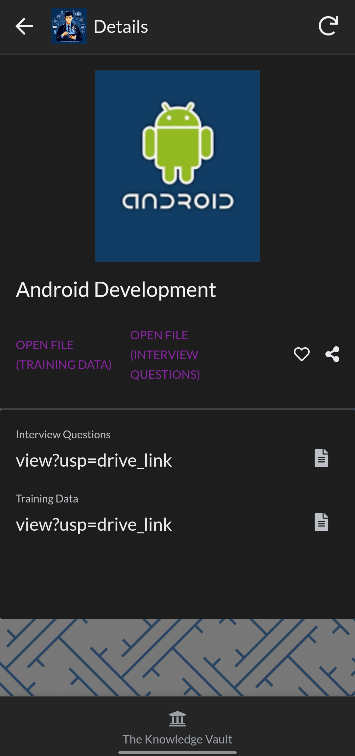
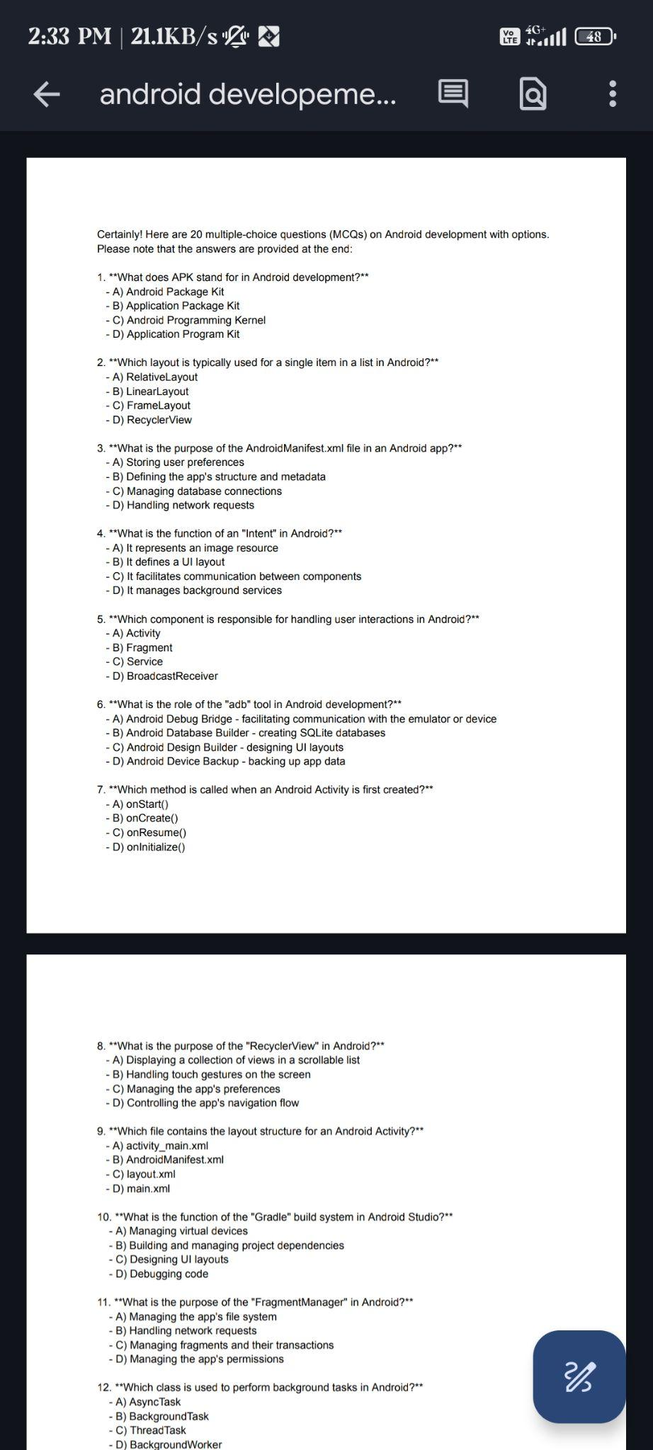
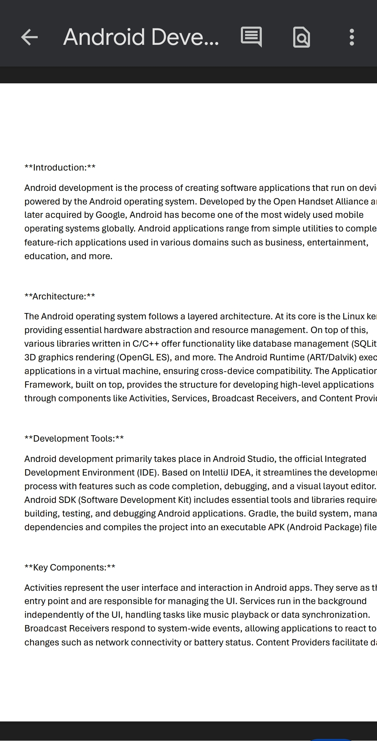
In training data there are interview question which helps in acing and cracking the interview. These questions are verified by top HR’s . Access to detalied notes from beginner to advance and tips for monitezation and earning.

Slide 11
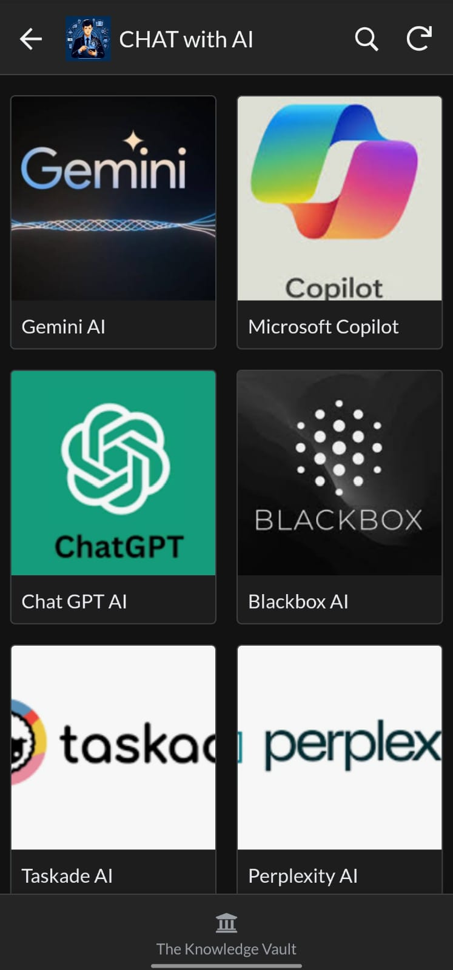
Chat with AI Consists of 6 AI tools
1.Gemini AI 2.Copilot AI
3.Chat Gpt AI 4.Blackbox AI
5.Taskade AI 6.Perplexity AI

Slide 12
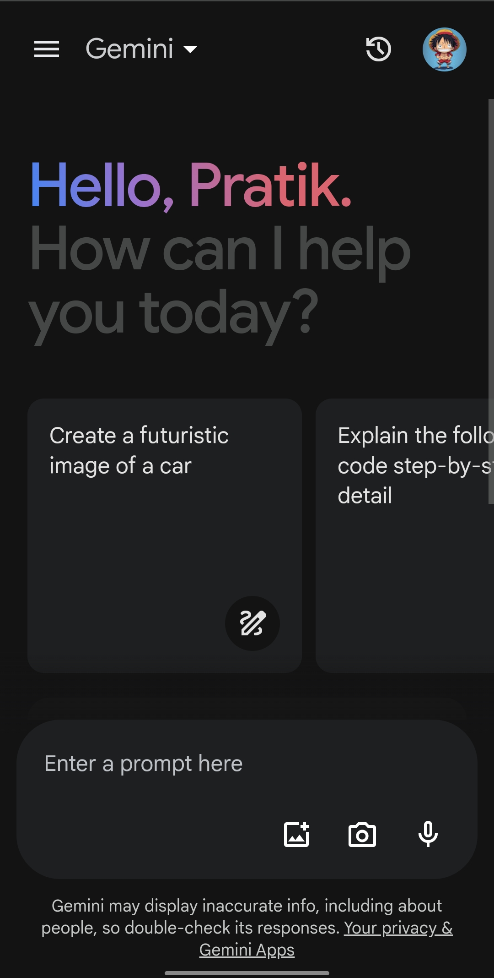
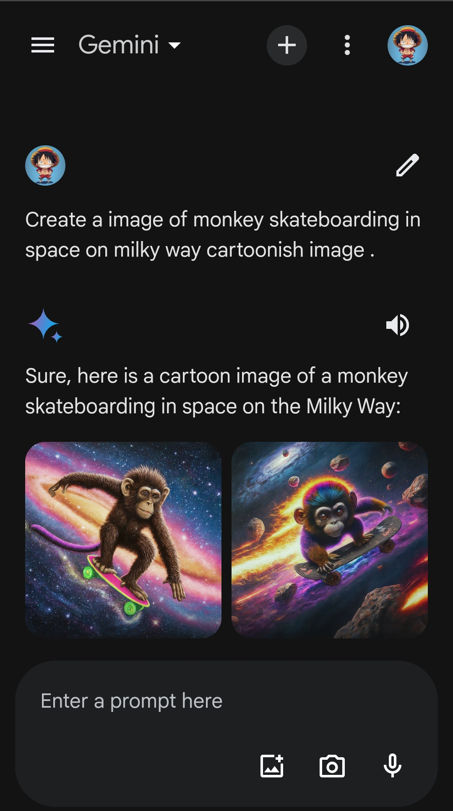
Gemini AI: Is an innovative artificial intelligence platform focused on enhancing user experiences through personalized recommendations and insights. Utilizing advanced machine learning algorithms, Gemini AI analyses data to deliver tailored solutions across various industries, from e-commerce to entertainment. Its adaptive capabilities empower businesses to optimize decision-making processes and drive meaningful engagement with their audience.

Slide 13
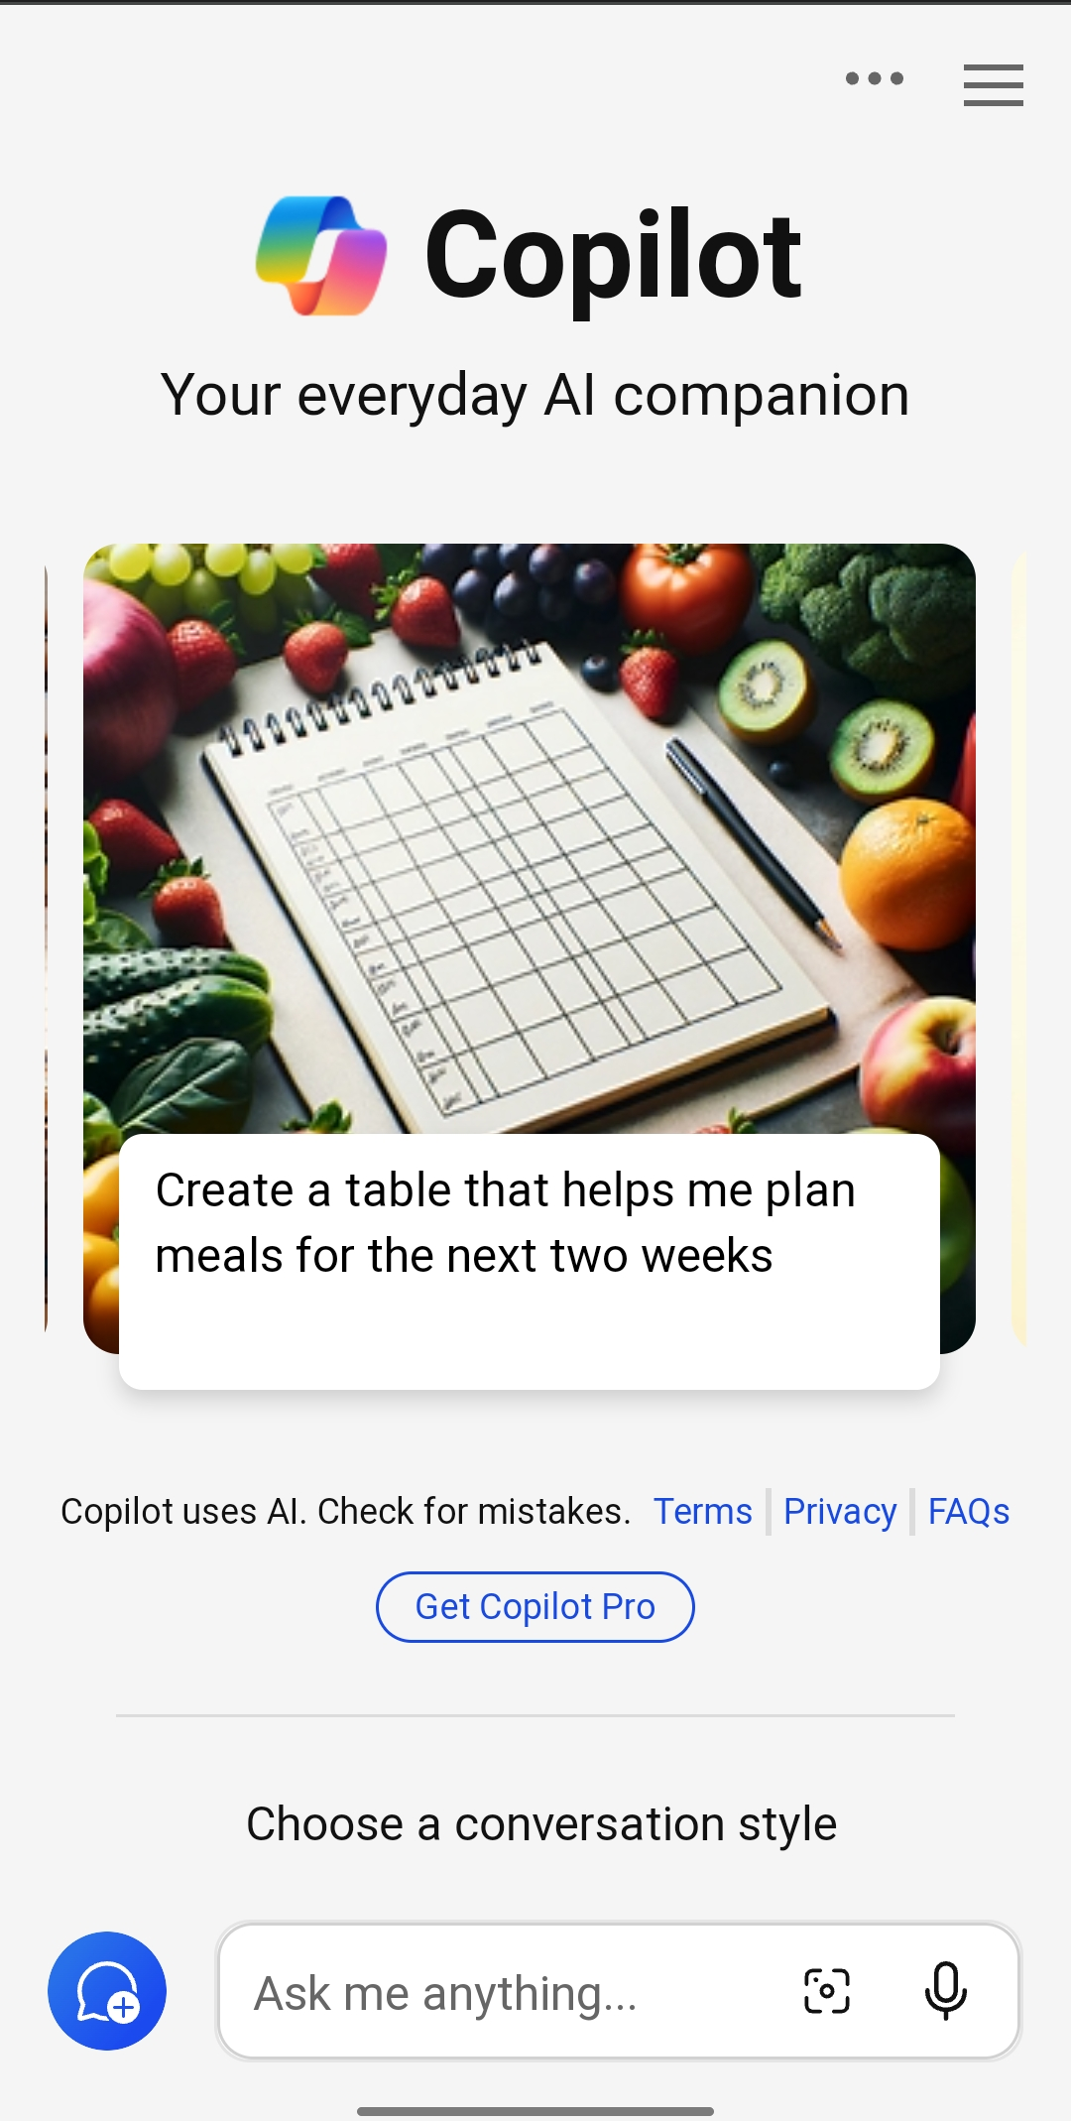
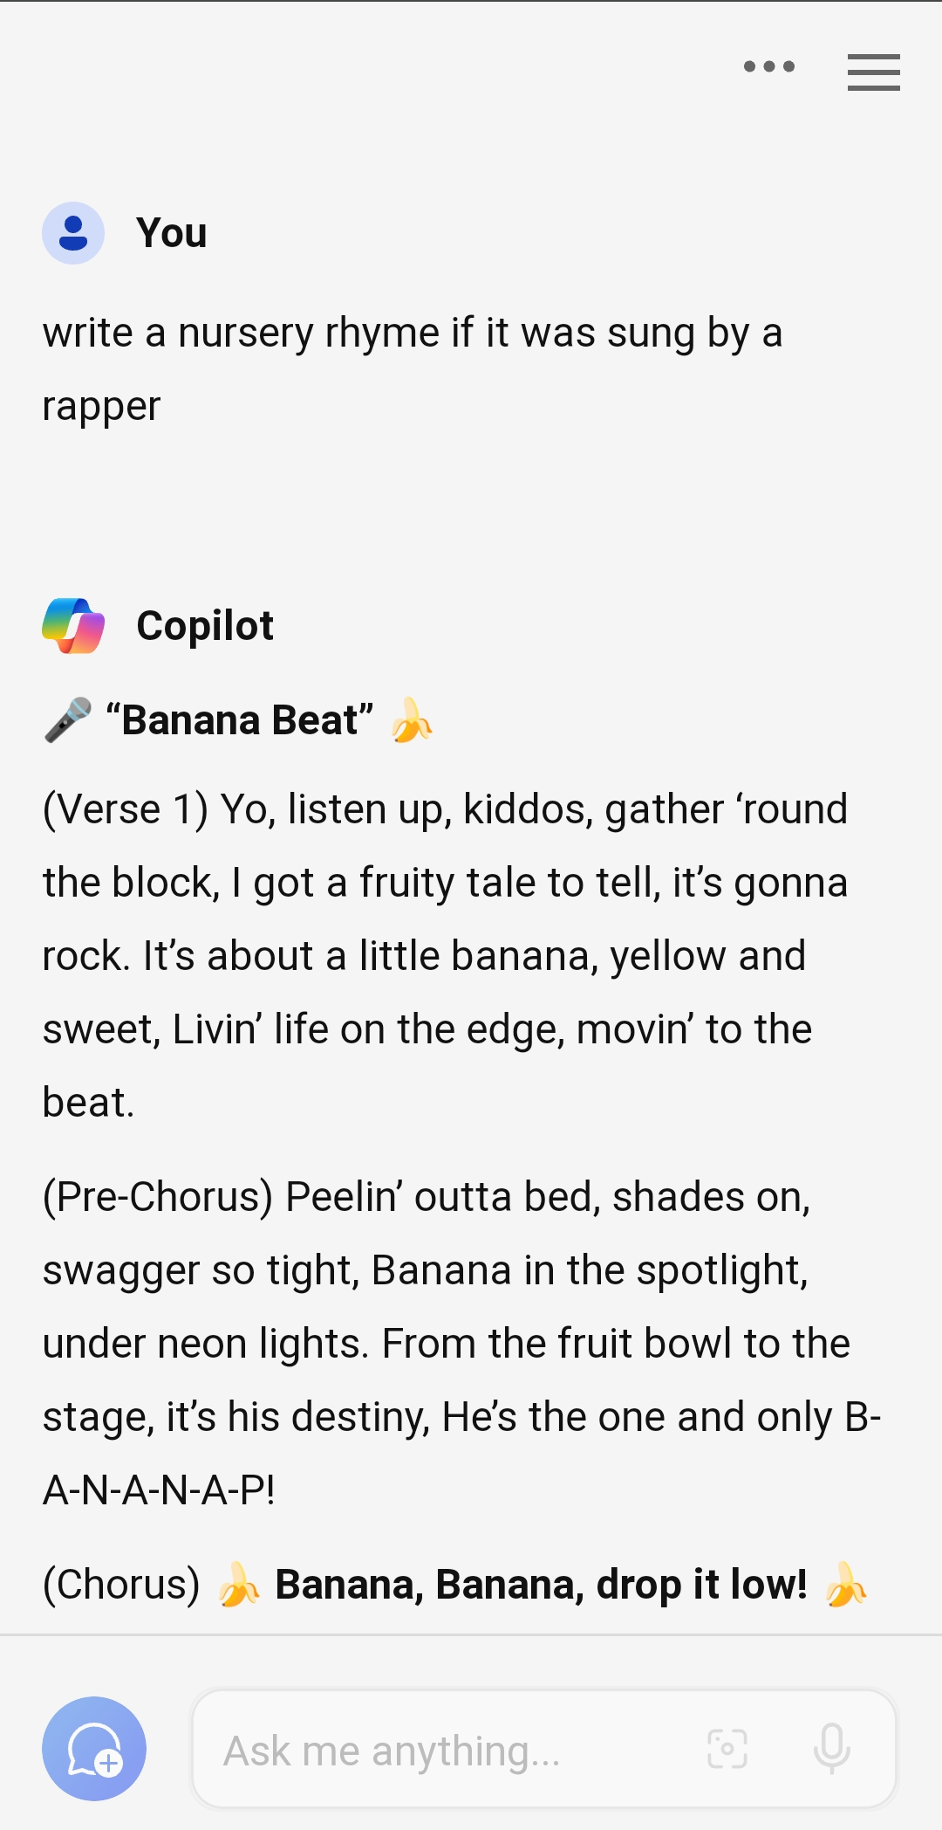
Copilot AI: Is a cutting-edge artificial intelligence tool developed by GitHub and OpenAI, designed to assist developers in writing code more efficiently. Leveraging the power of GPT-based models, Copilot provides real-time suggestions, auto-completion, and code generation, significantly streamlining the coding process. Its collaborative nature fosters productivity and fosters learning, making it a valuable resource for both seasoned programmers and newcomers to coding alike.

Slide 14
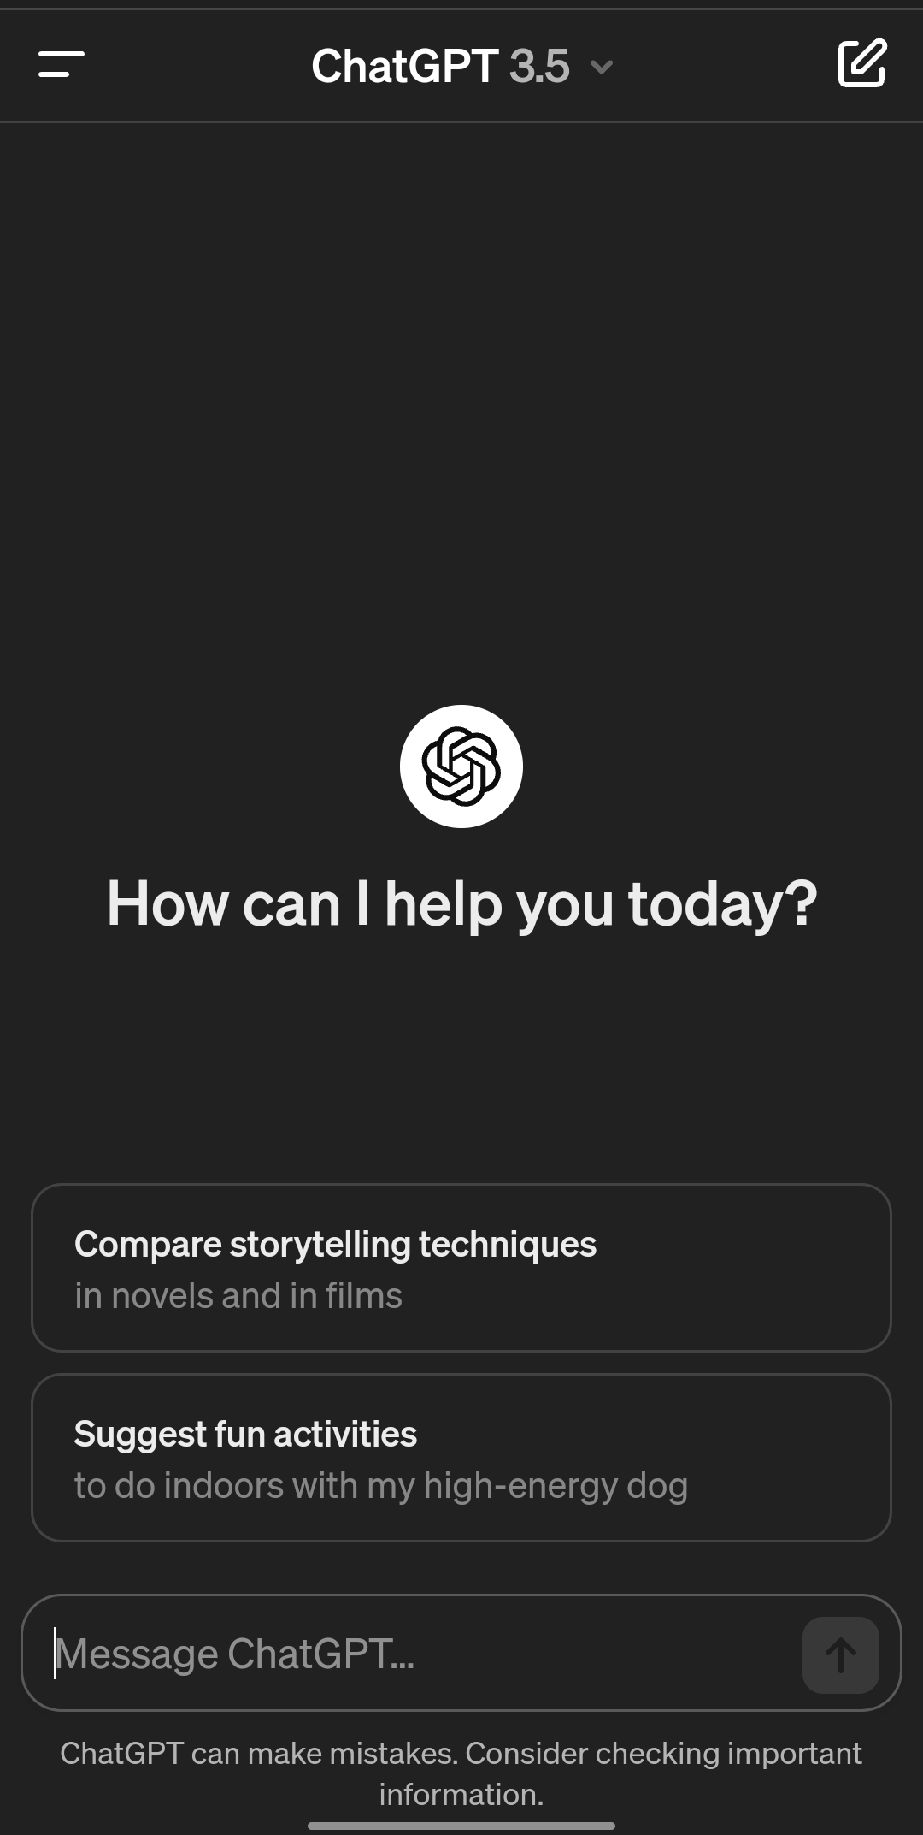
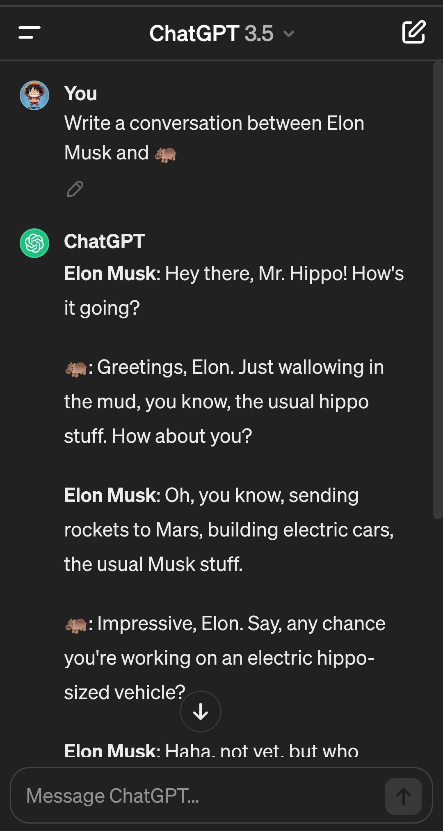
Chat Gpt : A natural language processing chatbot driven by generative AI technology that allows you to have human-like conversations and much more. The AI tool can answer questions and assist you with tasks, such as composing emails, essays, and code.

Slide 15
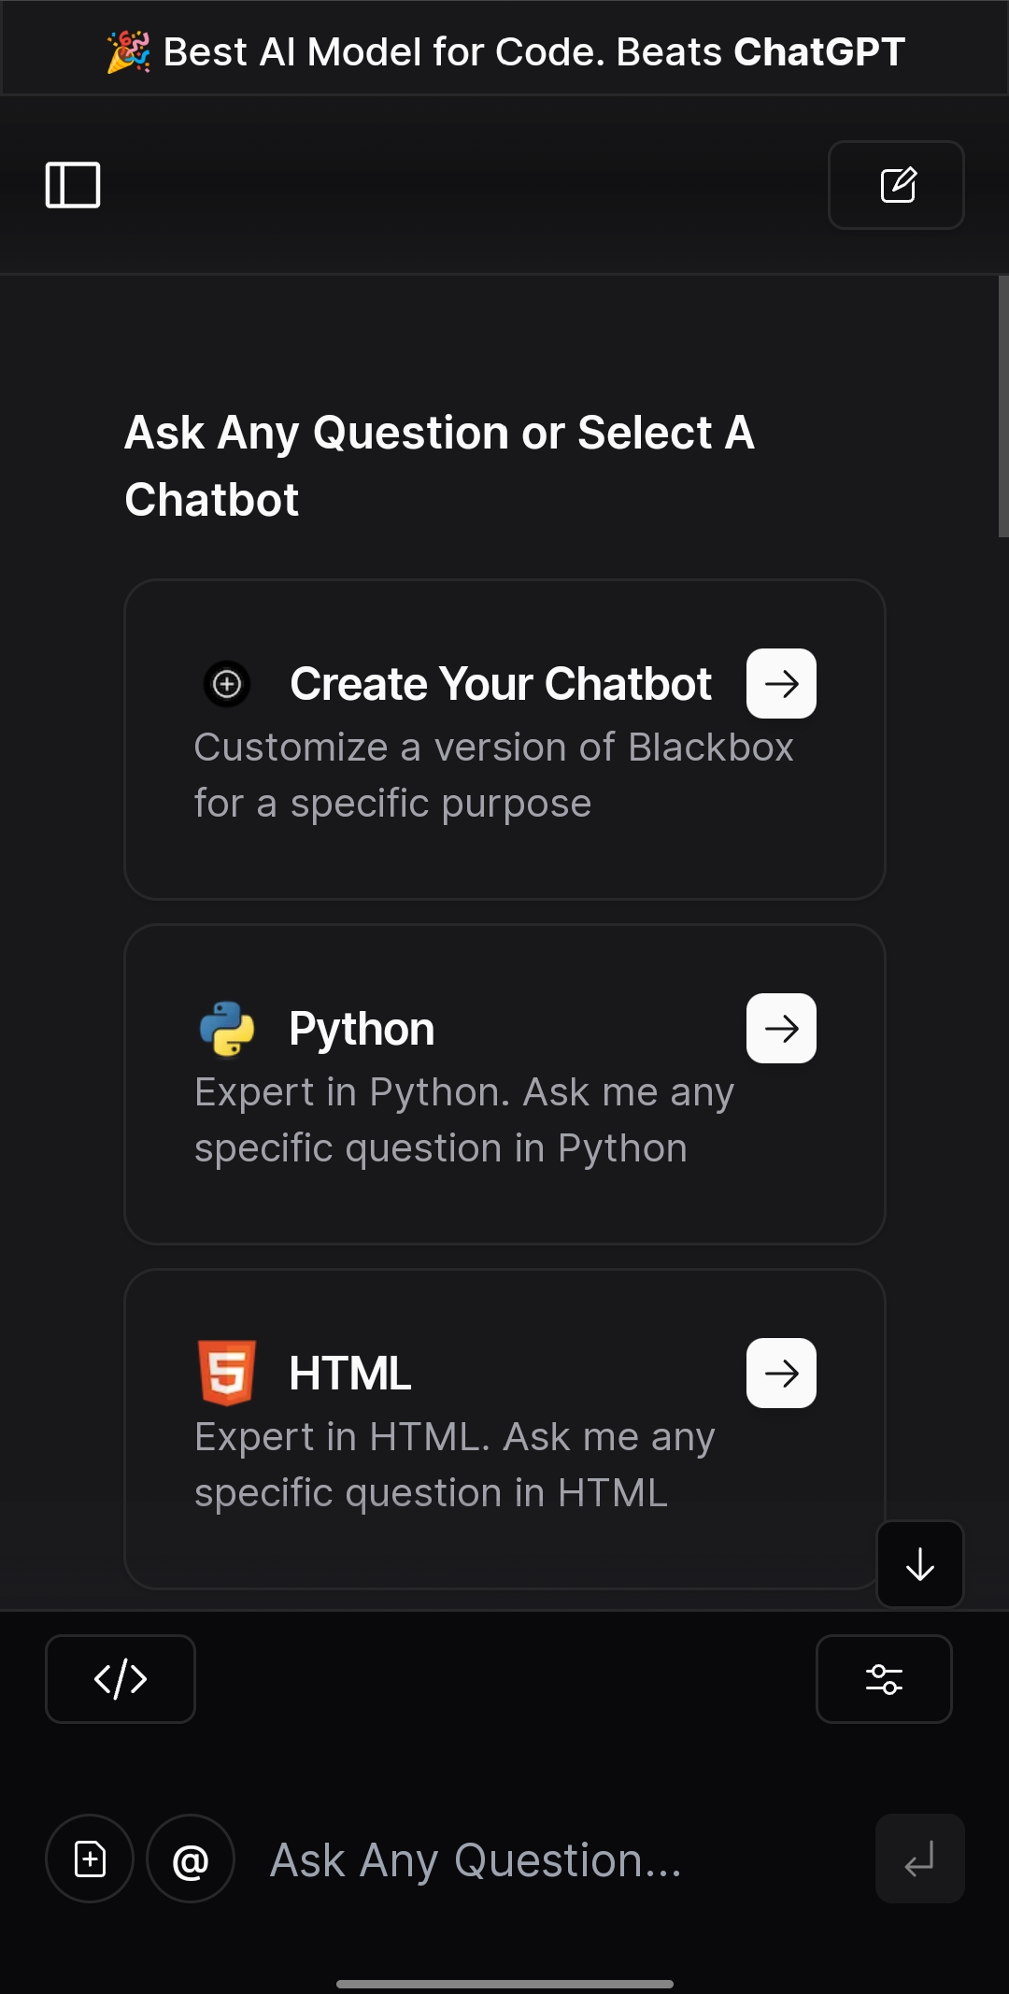
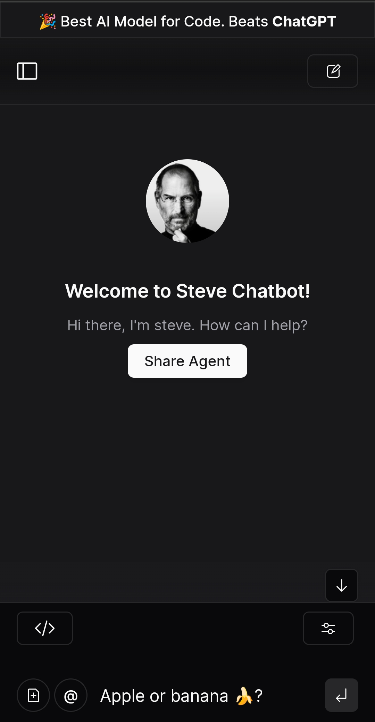
Black box AI : denotes opaque artificial intelligence systems, concealing their decision-making processes from human understanding. Despite their efficiency in tasks, these systems raise concerns regarding accountability, bias, and ethical implications. Efforts to enhance transparency and interpretability are crucial for ensuring trustworthiness and alignment with ethical standards.

Slide 16
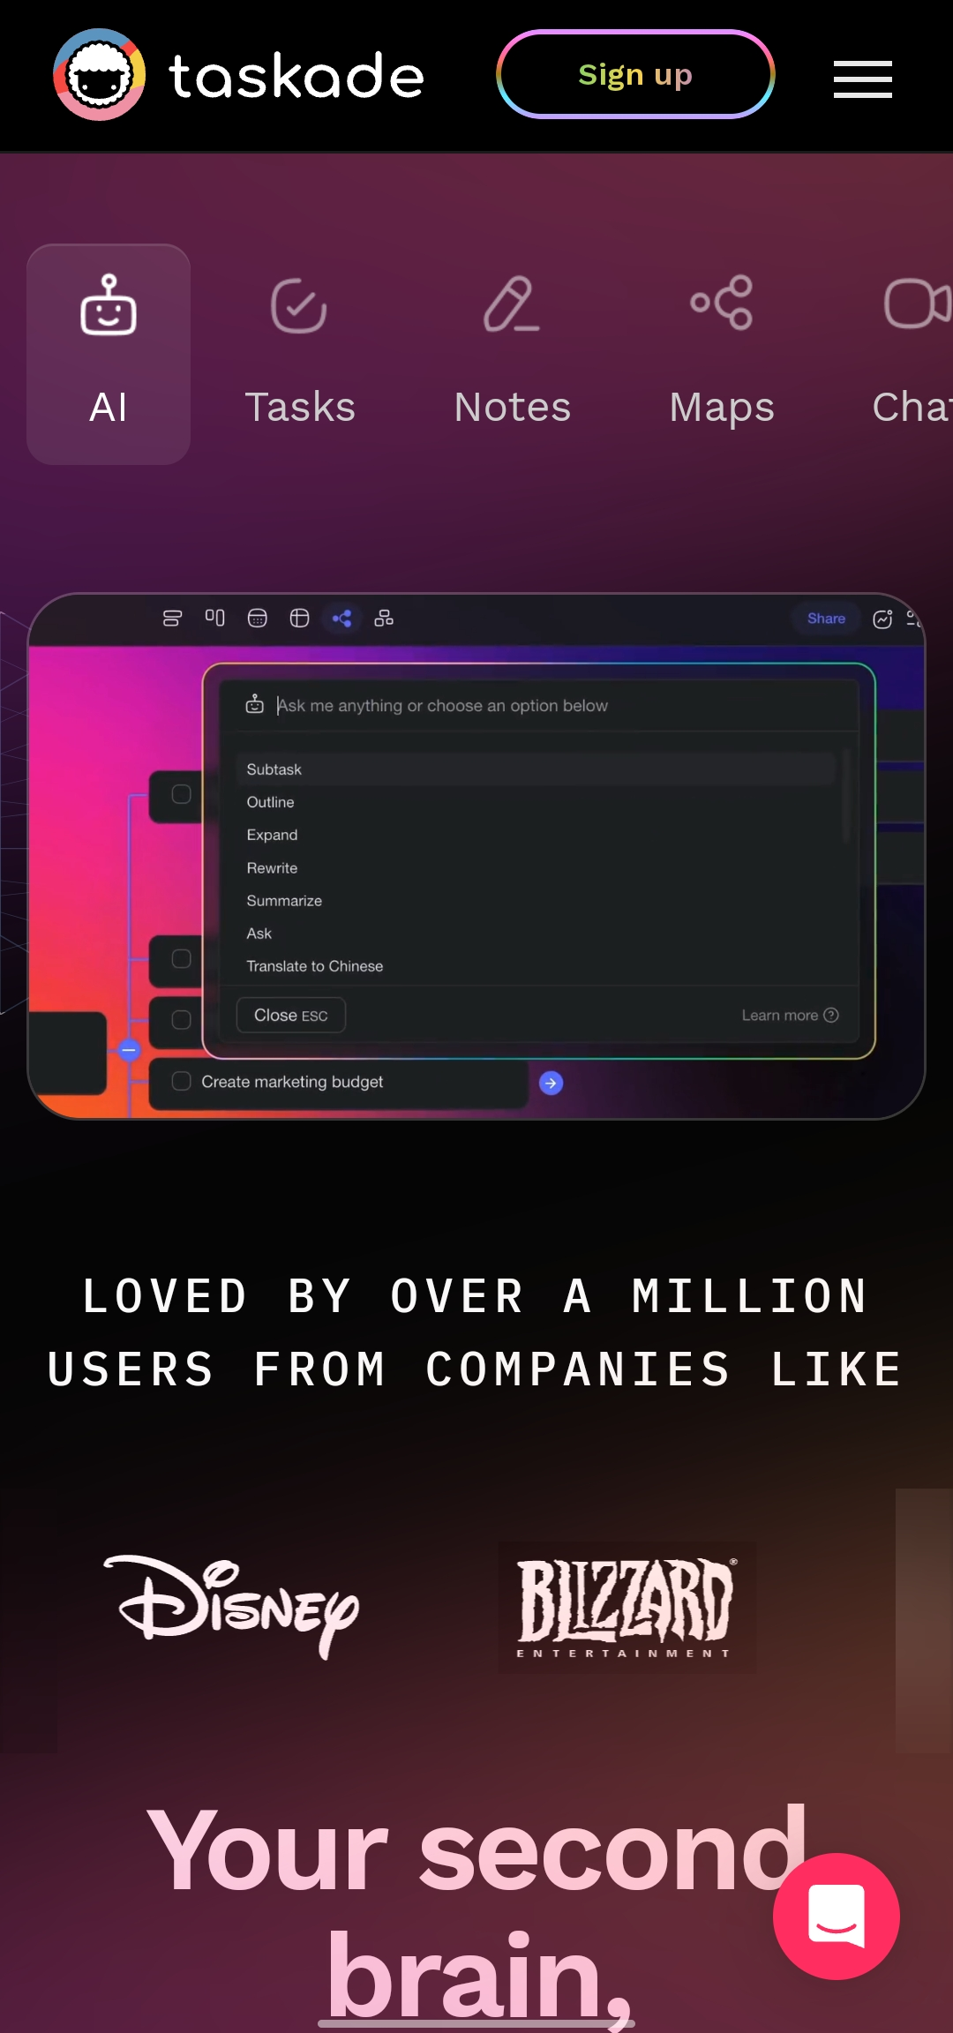
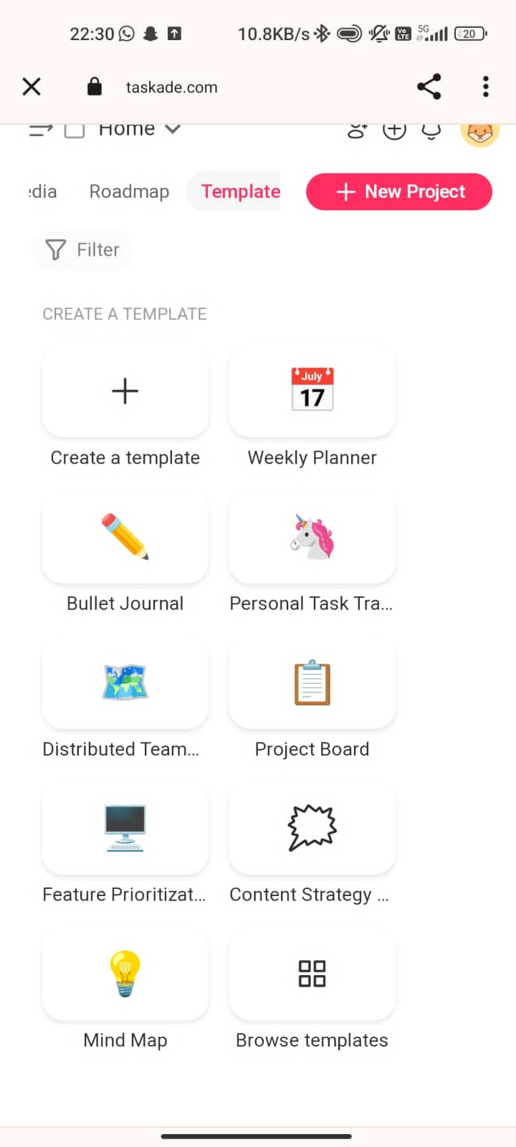
Taskade AI : enhances productivity by providing smart task management solutions, leveraging advanced algorithms to streamline workflow organization and collaboration. With features like intelligent task prioritization, natural language processing, and automated scheduling, Taskade AI simplifies project management and boosts team efficiency. Its adaptive capabilities adapt to user preferences, enabling seamless integration into various work environments and empowering teams to achieve their goals more effectively.

Slide 17
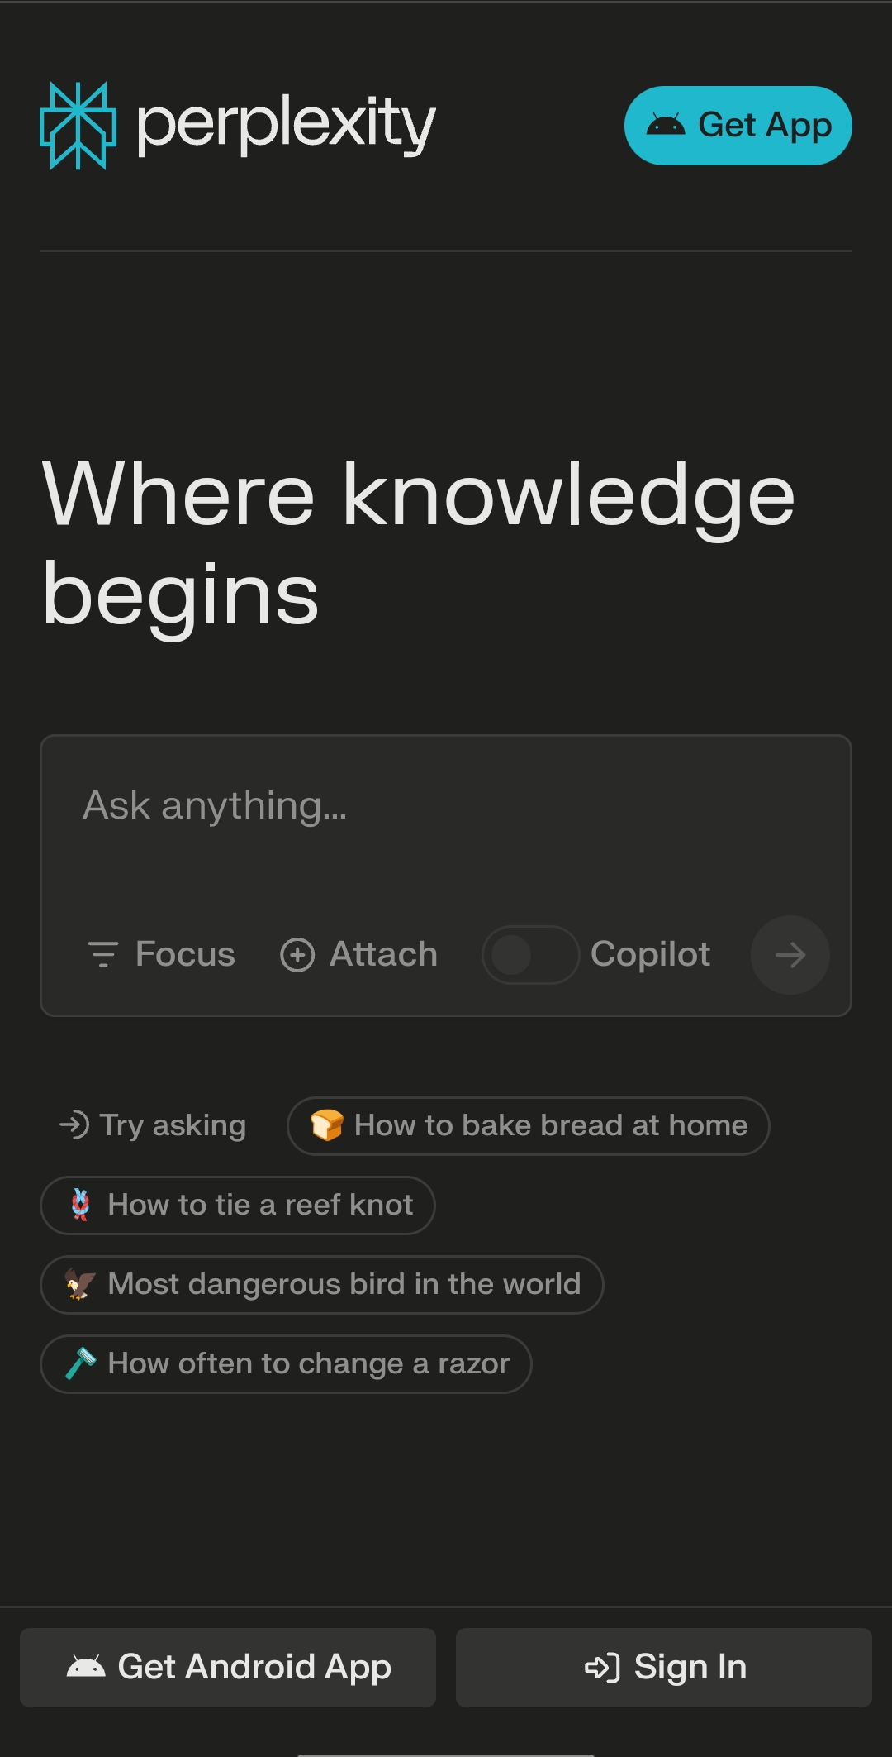
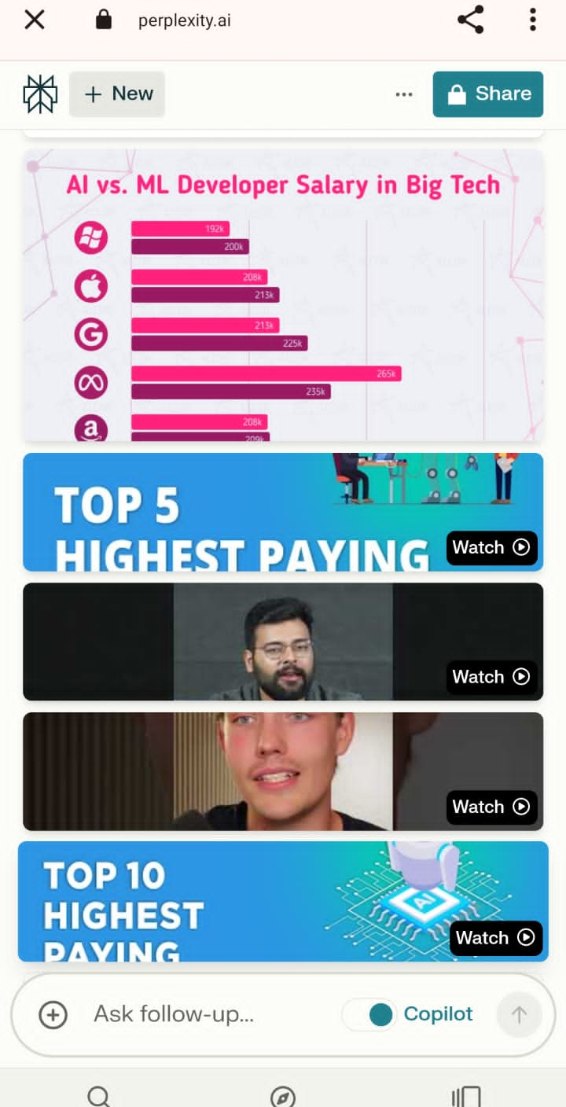
Perplexity AI : is employed in natural language processing tasks to assess the effectiveness of language models. By measuring how well a model predicts a given sequence of words, perplexity helps gauge its ability to understand and generate coherent text. Lower perplexity values signify higher accuracy and proficiency in language modeling, guiding improvements in speech recognition, text generation, and other NLP applications.

Slide 18
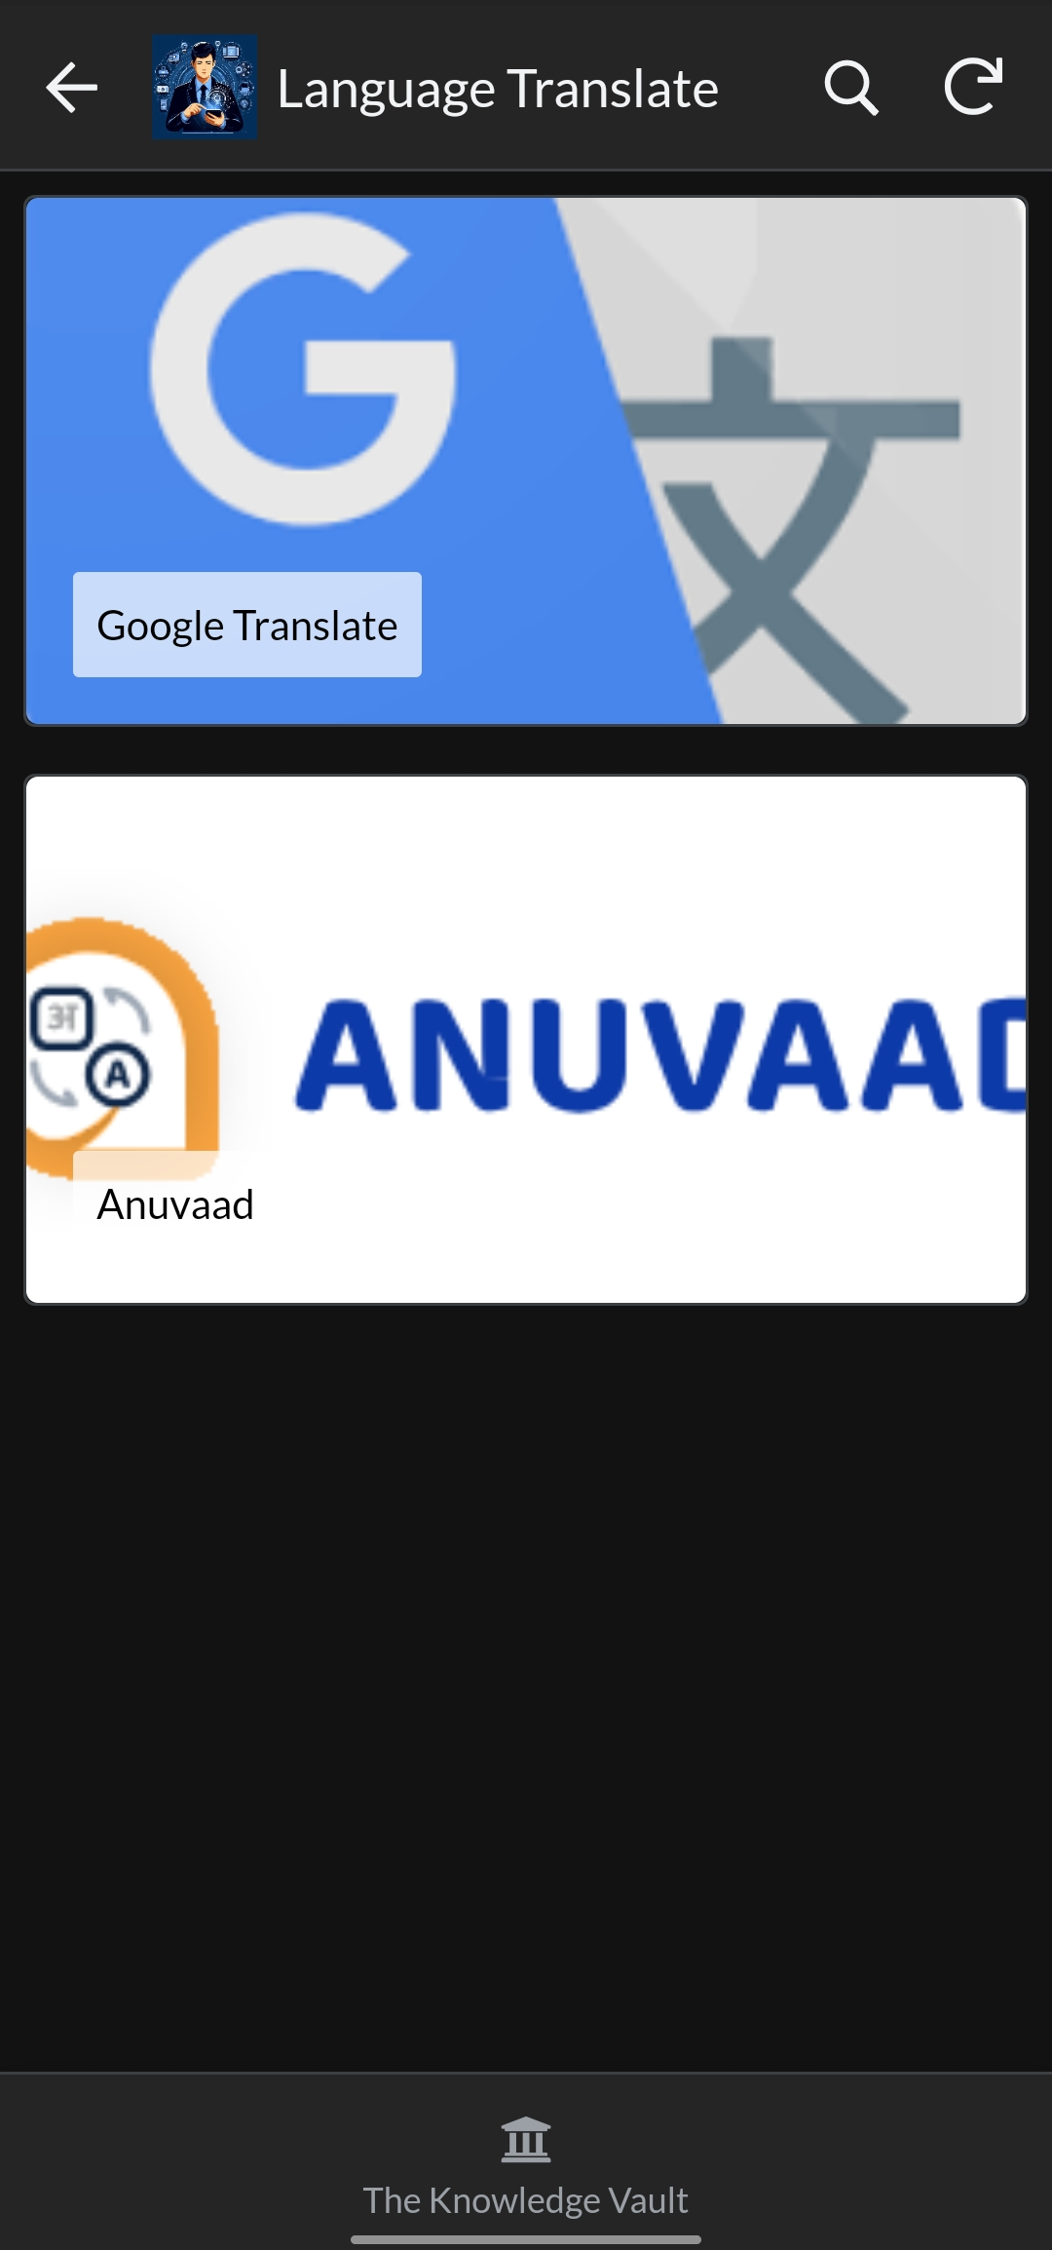
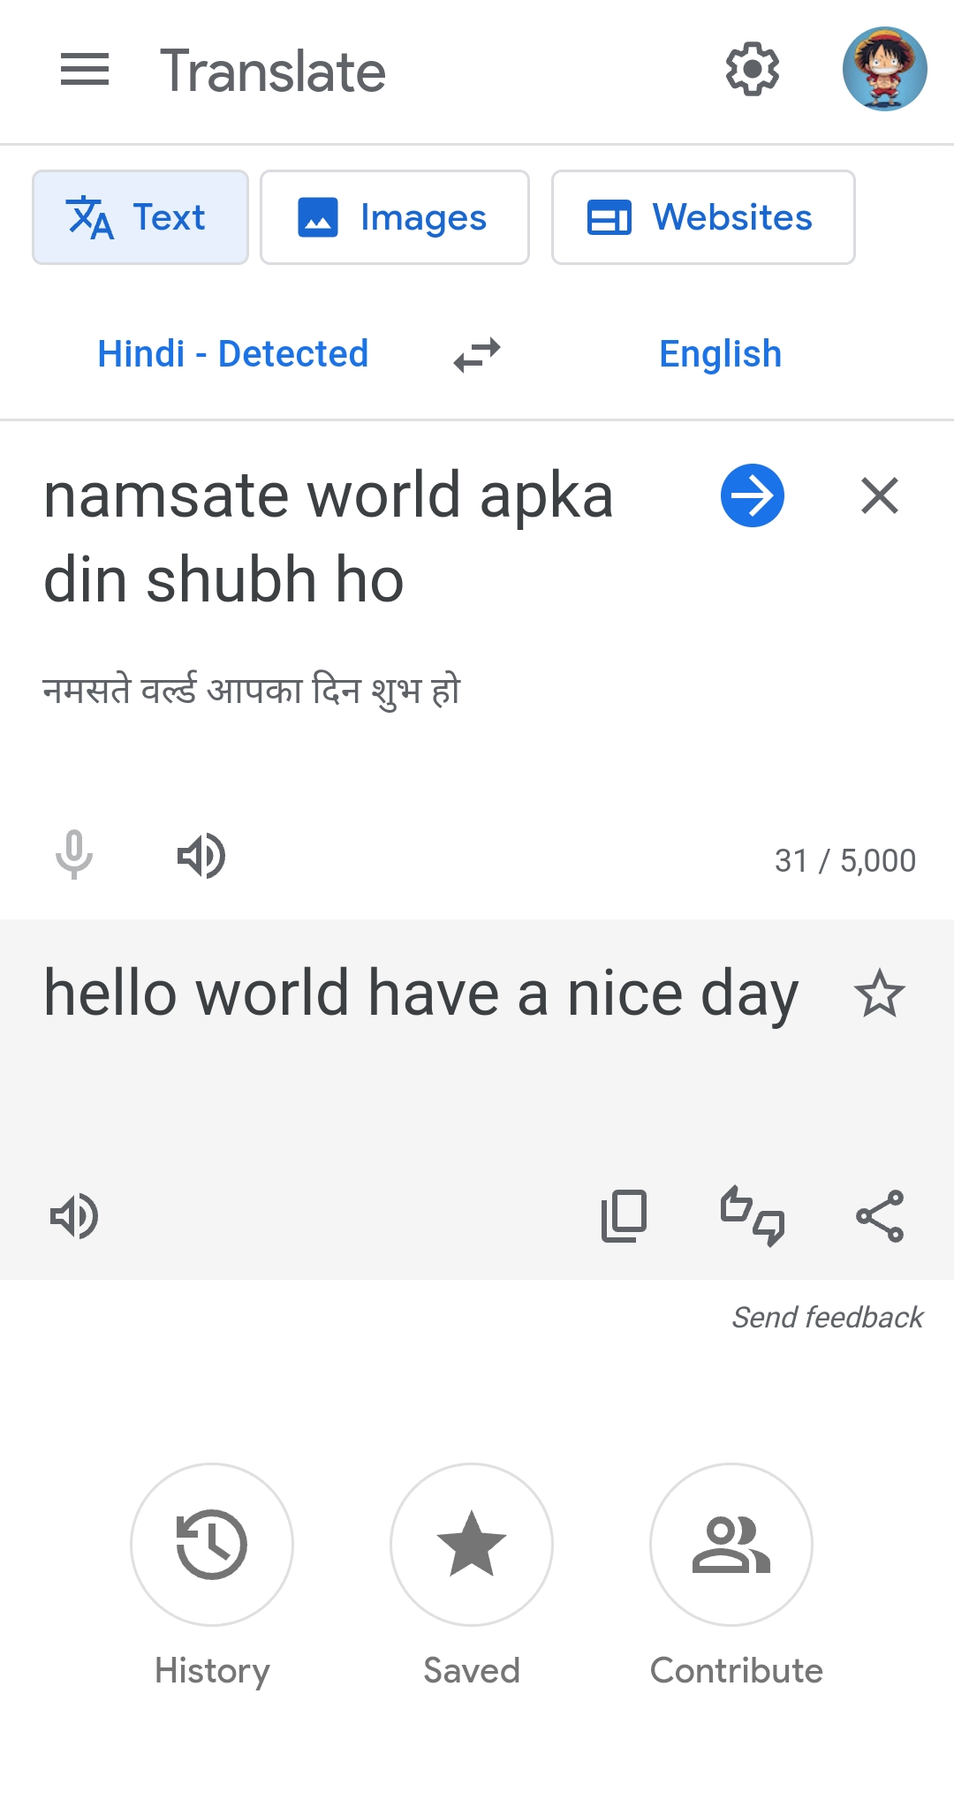
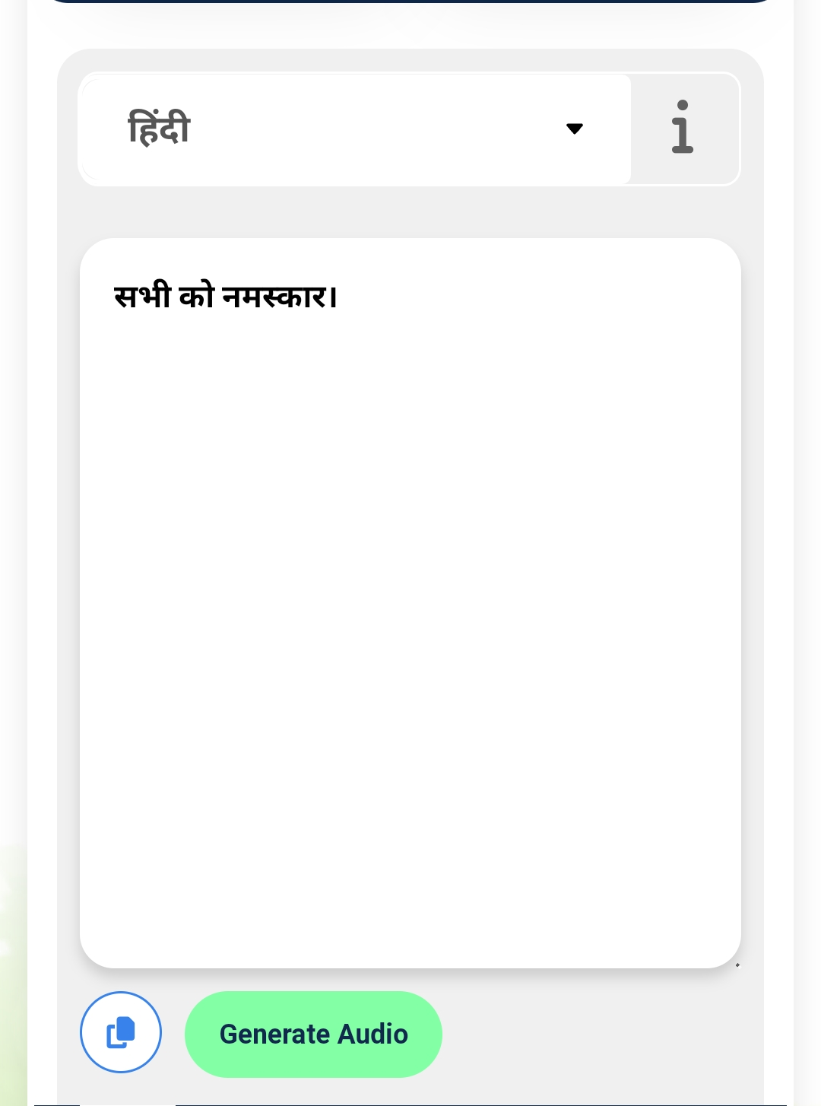
The language Translate tab has Two translators: 1. Google Translate 2. Anuvaad
You can overcome language barriers in 4 ways :
a. Text to text b. Voice to voice c. Image to text or voice d. Paste Url link

Slide 19
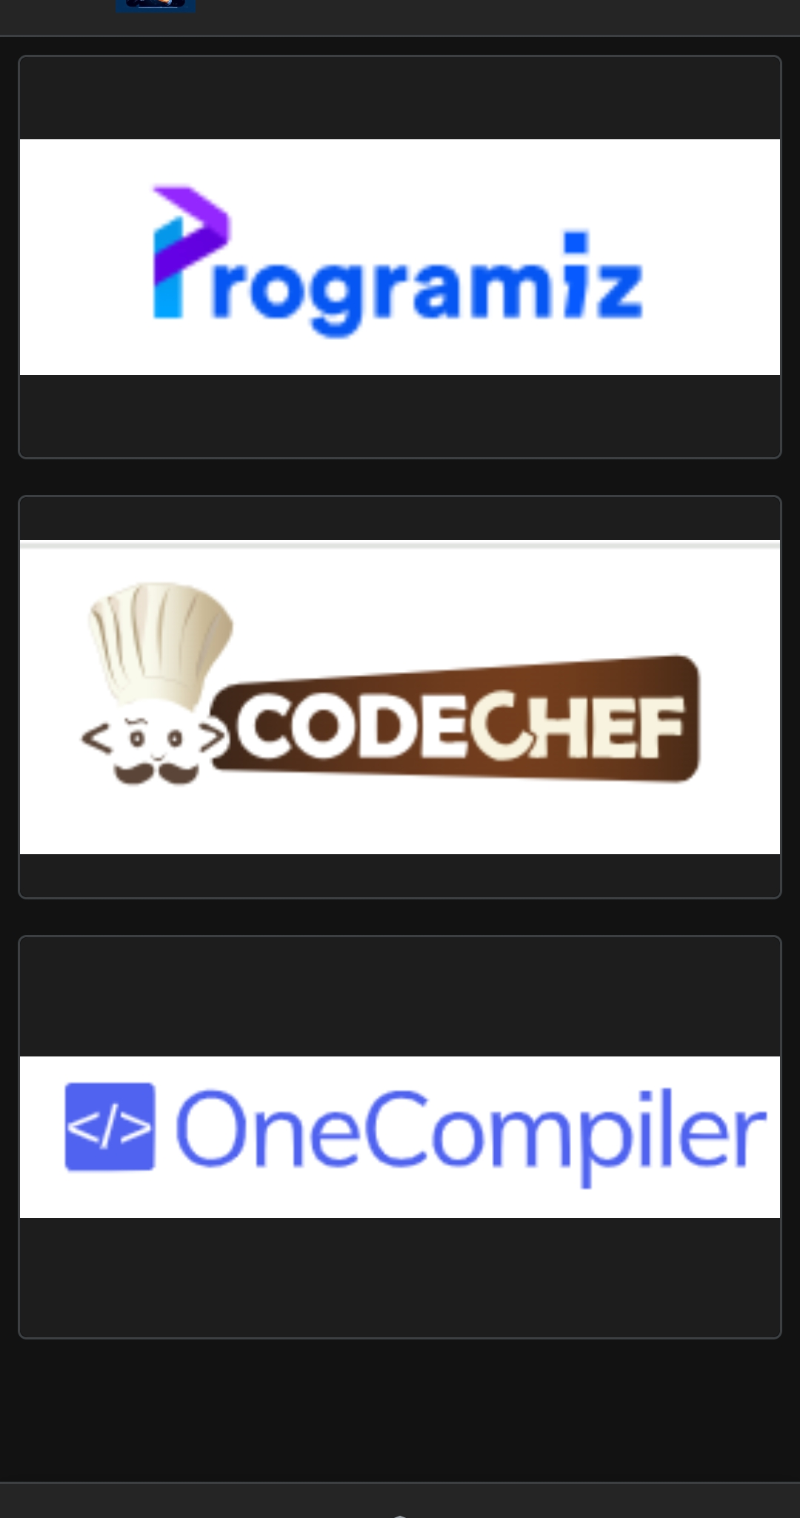

The Coding Platform Tab Has 3 Integrated Compliers :
1.Programiz
2.Codechef
3.OneCompiler

Slide 20
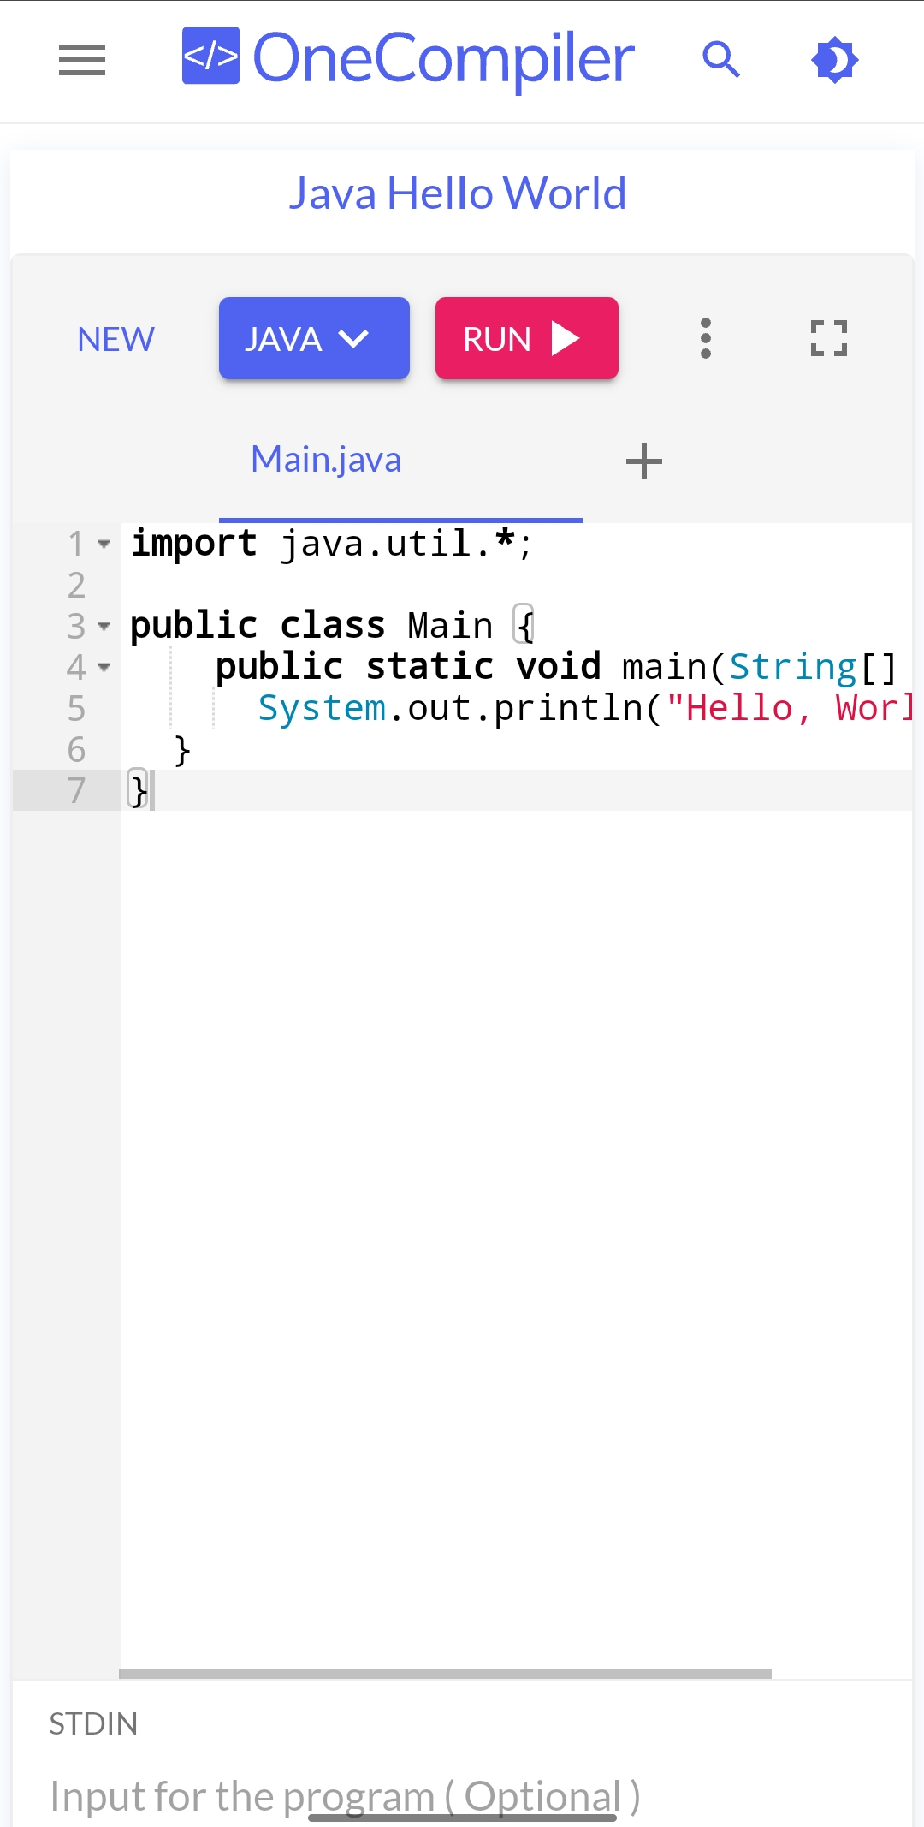

Program in all programing languages and also you can practice for competitive coding and earn certificates.
To ensure our users have a amazing learning experience without any distractions !

Slide 21

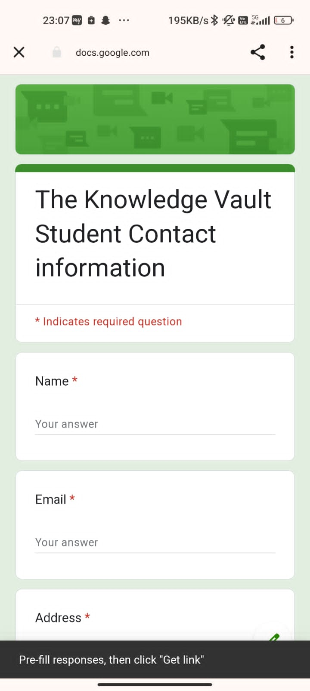
The Support Forum Tab Provides :
Connect With Right People
Mentorships
User Support

Slide 22
Justification for Our Choice
Creating app to aid coding beginners' challenges
Empathy driven education
Accessible learning for all
We aim to make coding education accessible and friendly for all.
Make coding education inclusive and welcoming for all
Breaking barriers
Supporting aspiring coders
Empower beginners on a guided coding journey.
App fosters coding confidence in a supportive environment.
Boosting confidence

Slide 23
SUCCESS & COMPLETION OF SOLUTION
THIS APP WIL TACKLE THE SDG 4 (QUALITY EDUCATION ) BY : DETAILED NOTES , SEQUENCIALISED VIDEO FOR LEARNING FROM SCRATCH, BASIC TO ADVANCED LEVEL UNDERSTANDING .
IT WILL CONSIST OF AI TOOLS LIKE : CHATGPT , BARD AI ( GOOGLE ) AND BLACKBOX AI AND IT WLL MAKE HUGE DIFFERENCE AND PROGRESS IN THE WORLD.
STORAGE : STORING DATA IN CLOUD STORAGE.

Slide 24



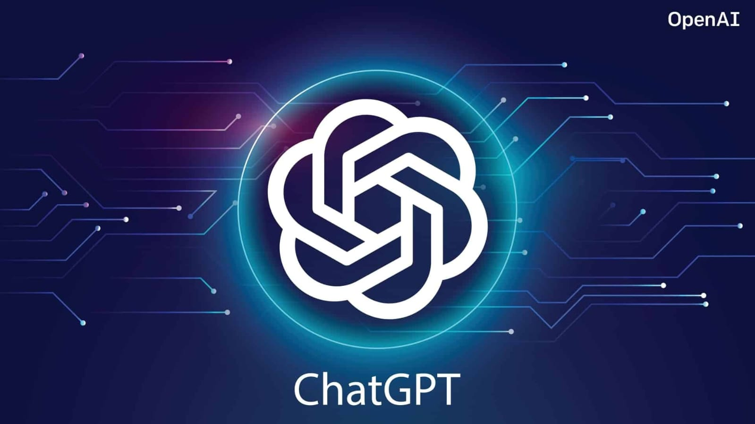

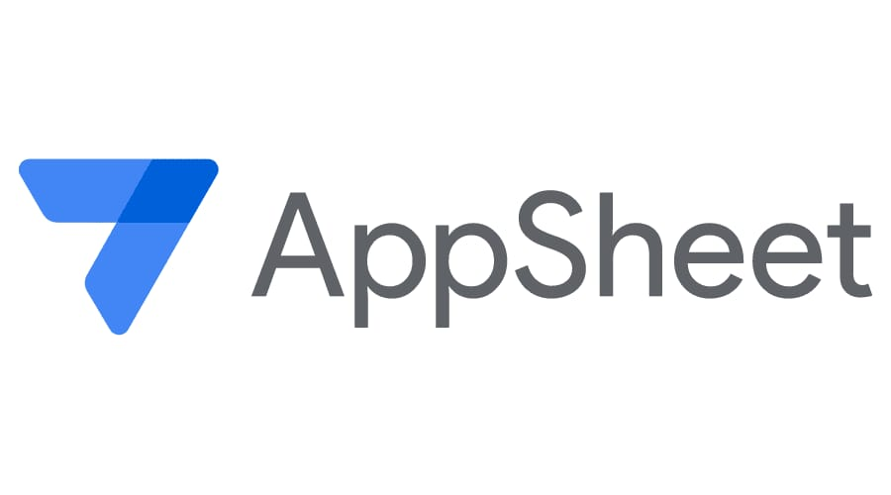












GOOGLE TECHNOLOGIES

Slide 25

Feedback point and our improvement on that :
The knowledge vault
The knowledge vault
The knowledge vault
The knowledge vault
Confusion?
Where to start ?
Tired of paid courses?
AI Tools ?
Notes ?

Slide 26
FEEDBACK / TESTING / ITERATION
Resolved by
UI Designing
Using Google Appsheet
Storage
Using Multiple Google Drive Accounts
And cloud storage.

Slide 27
Impact on communities:-
CASE STUDY :
In essence, this solution pledges to confront the challenges associated with SDG 4 (Quality Education), actively advancing its objectives. By facilitating the acquisition of literacy among the youth through the delivery of quality data and learning opportunities, this application contributes significantly to the fulfillment of these goals.
Sequenced Learning: Structured
AI Tools : Personalized
Community Building: Collaborative
Empowerment: Self-efficiency
Global Reach: Inclusive

Slide 28

SCALABILITY
REACHING MORE : COLLABRATION WITH GOVERNMENT SCHEMES AND PARTNERSHIP .
INSPIRE THE NEXT GENERATION : GETTING FAMILIAR WITH AI
OPEN YOUR DATA : SHARING PROBLEMS AND SOLVING TOGETHER .
INTRODUCING MORE FEATURES : MORE AI TOOLS AND UPDATED EDUCATION TECHNOLOGY.
PRIVACY AND SECURITY : BETTER ACCESS CONTROL AND DATA SECURITY WITH SAFE SIGN IN.
SUPPORTED BY BOTH ANDROID AND IOS .

Slide 29

THANK
YOU

